Slide 1

CSE3BDC/CSE5BDC
Big Data Management on the Cloud
Lecturer: Zhen He
Lecture 7 Appendix

Slide 2
Remember PageRank

Slide 3
Spark Implementation
val links = // Assume holds RDD of (url, neighbors) pairs
var ranks = // Assume holds RDD of (url, rank) pairs
for (i <- 1 to ITERATIONS) {
val contribs = links.join(ranks).flatMap {
case (url, (neighbors, rank)) =>
neighbors.map(dest => (dest, rank/neighbors.size))
}
ranks = contribs.reduceByKey(_ + _)
.mapValues(0.15/ranks.size + 0.85 * _)
}
ranks.saveAsTextFile(...)
After flatmap
dest | rank/neighbor.size
B | 1.0
C | 1.0
B | 0.5
D | 0.5
A | 0.5
B | 0.5
After reduceByKey
After join
dest | Sum contribs
B | 2.0
C | 1.0
D | 0.5
A | 0.5
url | neighbors | rank
A | B | 1.0
B | C | 1.0
C | B, D | 1.0
D | A, B | 1.0

Slide 4
How can we improve the performance?
The same Links RDD is used repeatedly, currently it is loaded from disk every time. We can cache the Links RDD in RAM to stop the repeated loads
val links = // Assume holds RDD of (url, neighbors) pairs
var ranks = // Assume holds RDD of (url, rank) pairs
links.cache() // cache the links RDD in RAM
for (i <- 1 to ITERATIONS) {
val contribs = links.join(ranks).flatMap {
case (url, (neighbors, rank)) =>
neighbors.map(dest => (dest, rank/neighbors.size))
}
ranks = contribs.reduceByKey(_ + _)
.mapValues(0.15/ranks.size + 0.85 * _)
}
ranks.saveAsTextFile(...)

Slide 5
Can we improve this further?

Slide 6
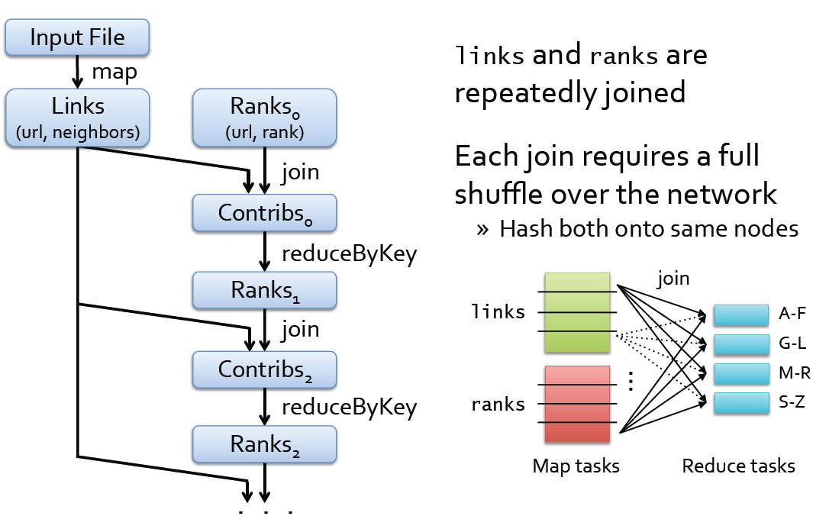
PageRank Execution

Slide 7
Solution
Pre-partition the links RDD so that links for URLs with the same hash code are on the same node.
Note the use of partitionBy and mapValues below.
val links = sc.textFile(…).map(…).partitionBy(new HashParititioner(8))
val ranks = // Assume holds RDD of (url, rank) pairs
links.cache() // cache the Links RDD in RAM
for (i <- 1 to ITERATIONS) {
ranks = links.join(ranks).flatMap {
case (url, (neighbors, rank)) =>
neighbors.map(dest => (dest, rank/neighbors.size))
}.reduceByKey(_ + _).mapValues(0.15/ranks.size + 0.85 * _)
}
ranks.saveAsTextFile(...)

Slide 8
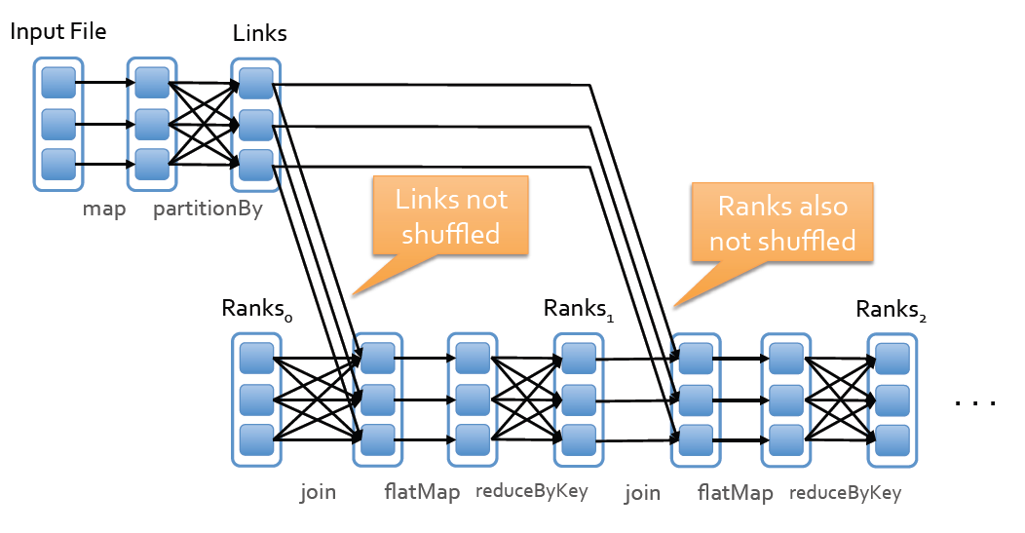
New Execution

Slide 9
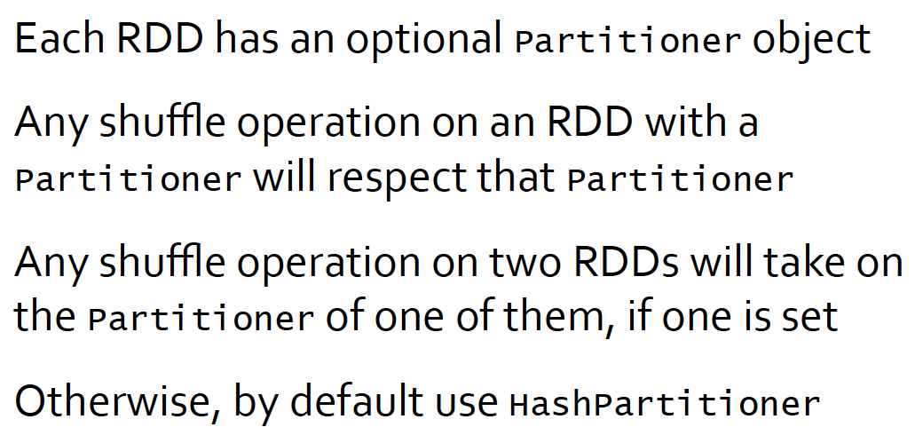
How it Works

Slide 10
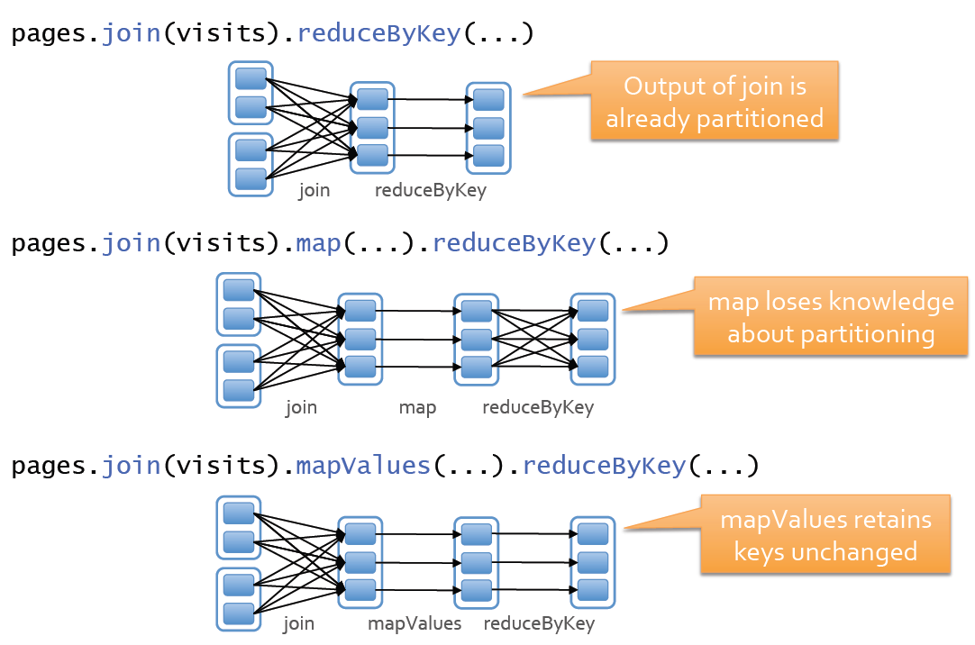
Examples

Slide 11
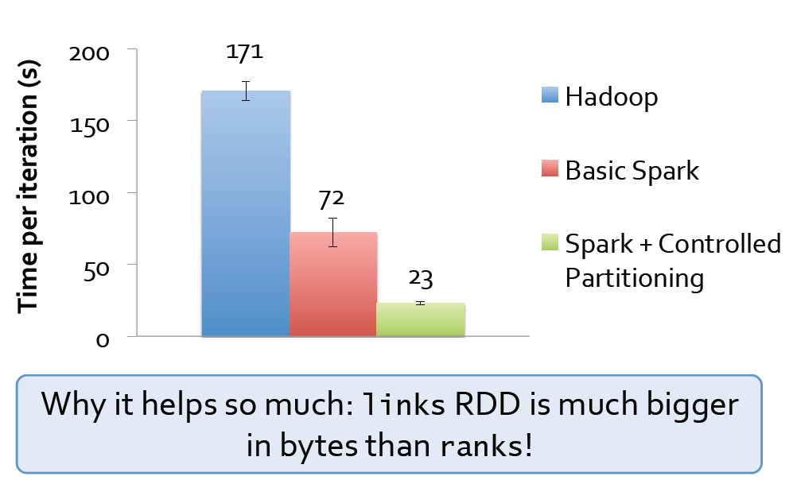
PageRank Performance

